Slide 1
System functions
Three main functions
Room availability and booking module
Housekeeping and staff management module
Reporting module

Slide 2
Room availability and booking module
Allow guest to search rooms and make booking
Receptionist, managers or Mr. Wang able to access and edit guest records.
Information that customer enter for booking are such as name, phone number, address, number of guest and check in date and time

Slide 3
Housekeeping and staff management module
Administrators can create staff account
Managers or Administrator will be able to assign duties to staffs
Staffs can login to their account to view their schdules

Slide 4
Reporting module
Able to generate room status report, all guest in one room report, all guest and room on a certain date report, room occupancy report and housekeeping report.
Able to preview reports before printing
Only management or administrators have full access to all reports.

Slide 5
User characteristics
End users
E.g. Staff of the hotel or customers
Staff and customers are able to access the room availability and booking module
Staff can also view some of the reporting module such as room occupancy module

Slide 6
User characteristics
Management users
E.g. Managers
Able to access all three functions
Able to edit stuff rosters
Access to all the reports

Slide 7
User characteristics
Administrators
E.g. Mr. Wang
Full access to all three functions
Able to create, edit or delete account of employees

Slide 8
General Constraints
Legacy Computer
Might not be compatible with the system that we are building.
Slow internet
Poses potential latency issues with connection with the system and customers.
Low backup rate
Backups are not done on a regular daily basis during non peak hours instead it is done on once a month basis.

Slide 9
Data Requirements
Booking
This table takes in most of the booking information of the customer
Check In Out
This table record the check in and out date and time.
Book detail
Shows which room the guest is assigned to
Room
This table shows all the room number, their type and the status of the room.

Slide 10
Data Requirements
Payment Detail
Stores the basic information of payment such as amount payable
Payment
Stores the credit card information if customer made payment by card
Account
This table will have login information of employee’s account
Staff
The basic information of employees such as as bank account and address are stored in here.
Duty Schedule
The duties and schedule of the employees are stored in this table.

Slide 11
Development Constraints
Used different versions of the software that can result in compilation error.
There could be major and minor bugs and errors occurring that could cause us to spend time in fixing those issues.
Different working hours due to some personal reasons.
Above mentioned constraints are not limited to other unexpected constraints.

Slide 12
Performance
Room availability and Booking Module
Create, Retrieve, Update, Delete
Housekeeping and Staff Management Module
Create, Retrieve, Update, Delete
Reporting Module
Create, Retrieve, Update, Delete
Login Creation Module (Mr & Mrs Wang)
Create, Retrieve, Update, Delete

Slide 13
Availability
Operating on 24/7 basis
2 hours downtime on every 1st Sunday from 0200 to 0400
Backups data every month

Slide 14
Security and Access Control
End Users
Customer
Receptionist
Management Users
Administrator (Mr and Mrs Wang)

Slide 15
User Interface Requirements

Slide 16
Interface with Other Systems
There will be no other system interfacing with our system as there was no system being implemented in the first place.

Slide 17
Assumptions
Before System Implementation
Payment can only be done manually before the system is being implement. Before implementation, payment transaction will happen when hotel guest checks out and many documents will be required.
Data can be only input manually before the system is being implement. Before implementation, a hotel staff will be responsible to key in other staff data into the database.
Smoking or Non-Smoking room cannot be chosen according to the customer preference.

Slide 18
Assumptions
After System Implementation
Payment can be done through the website. Transaction can be done via PayPal so everything will be mostly done without many documents.
Data can now be input automatically after the system is being implemented. Any hotel staff who are authorized to do so will then be able to input and update data at any point of time when required.
Smoking or Non-Smoking room can be chosen according to the customer preference.

Slide 19
Operating Environment
System will be deployed on Windows XP environment.
24/7, downtime once a month(Sunday) from 0200 to 0400.
3 Main Functions
Room availability and booking module
Housekeeping and Staff Management module
Reporting module

Slide 20
Special Requirements

Slide 21
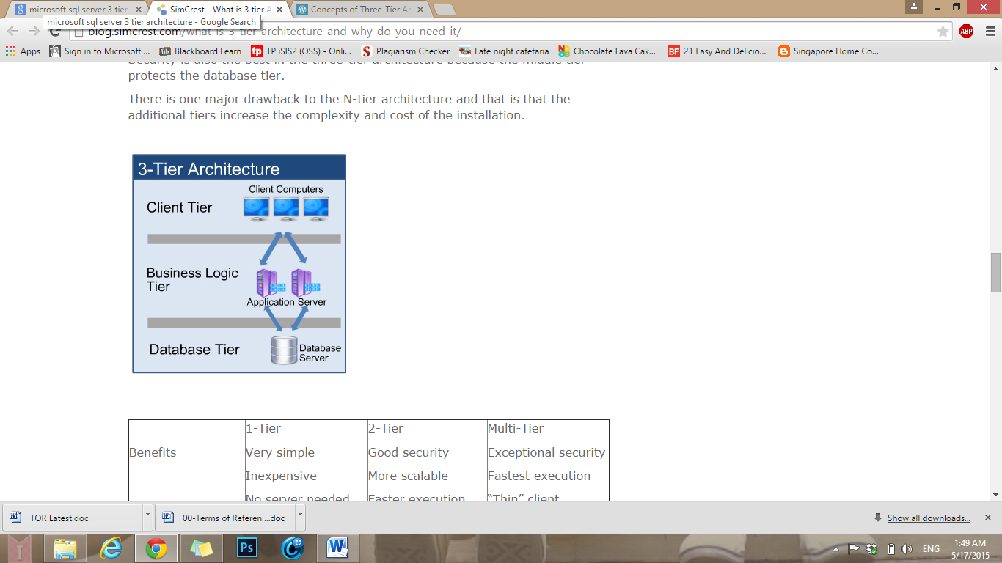
Architecture Design
3 Tier Architecture

Slide 22
3 Tier Architecture
Advantages
Maintainability: As each tier is independent, upgrades or changes can be carried out without affecting the whole application.
Scalability: Based on the placement of layers, removing or adding an application is reasonably straightforward.
Flexibility: As each tier can be controlled independently, flexibility is increased.
Availability: Applications can use the architecture to enable systems using easily accessible components, which increases availability.

Slide 23
3 Tier Architecture
Conclusion
upgrade or change the system anytime
upgrading or changing of the system would not affect the other tiers
controlled independently which allows more room for flexibility and can aid in customizing different needs for different tiers
can allow more business opportunities as more people can get to use it

Slide 24
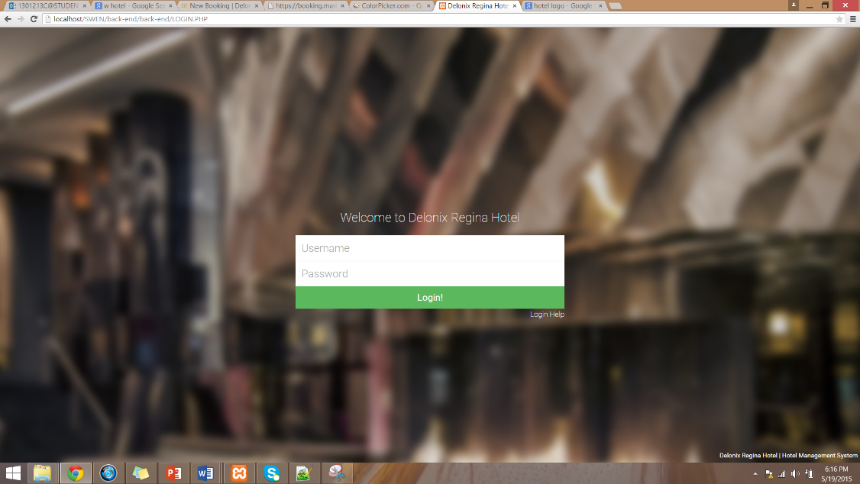
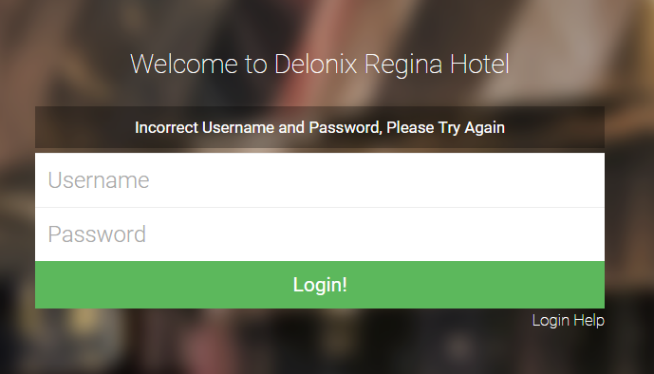
User Interface Design

Slide 25
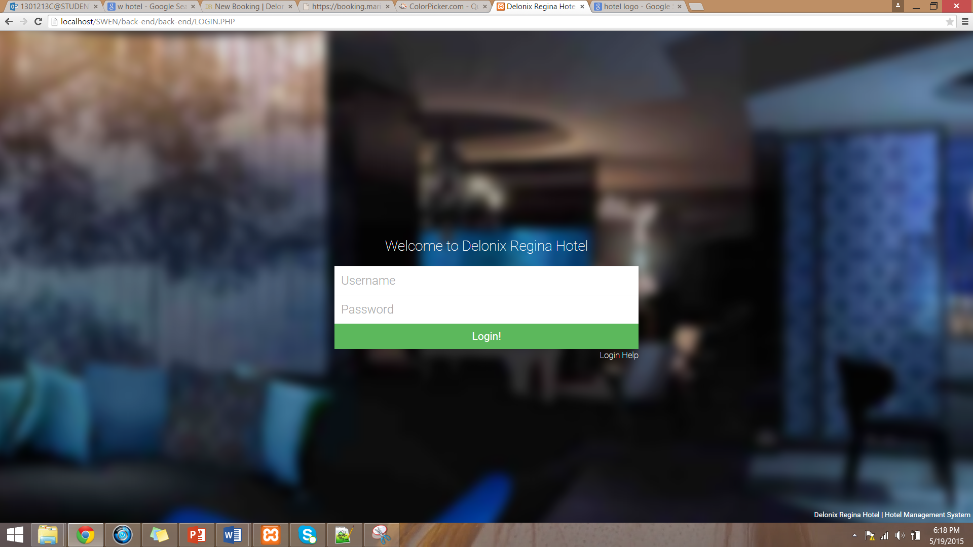
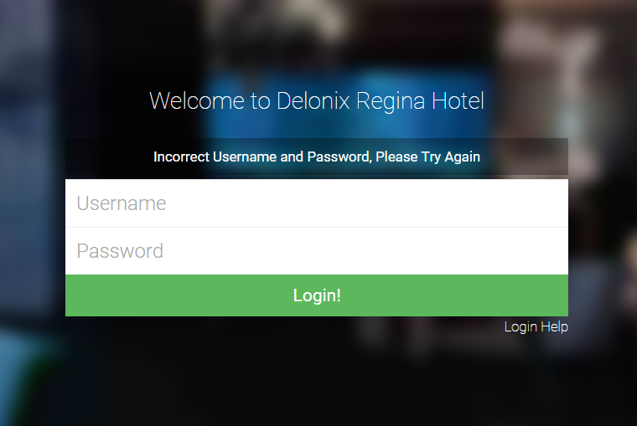
User Interface Design

Slide 26
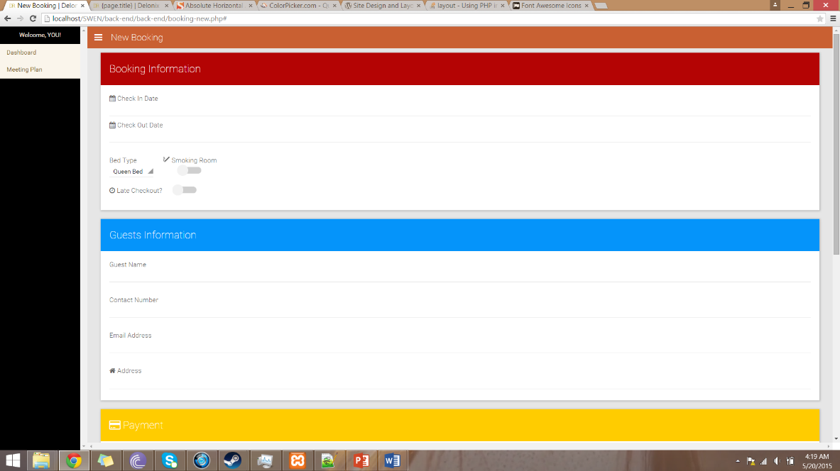
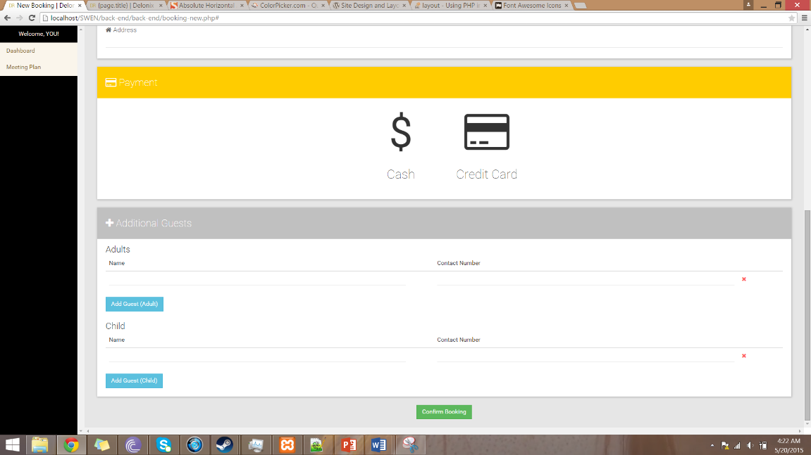
User Interface Design

Slide 27
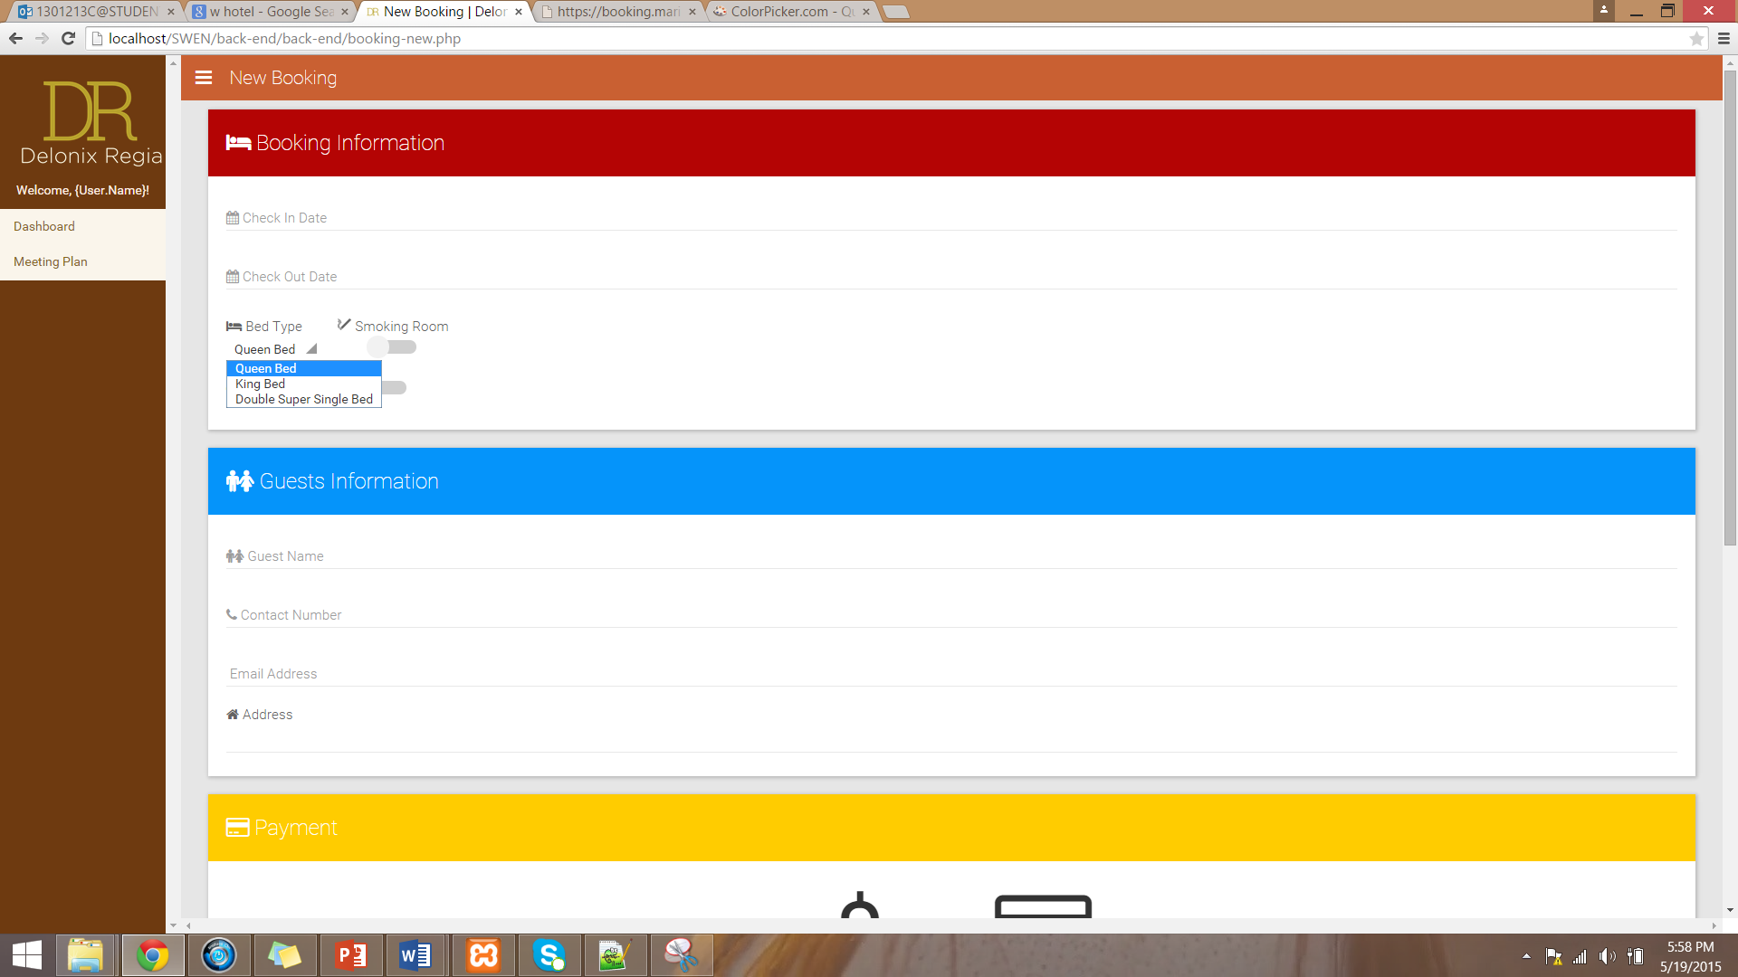
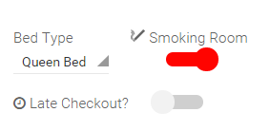
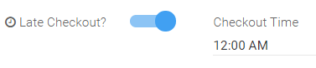
User Interface Design

Slide 28
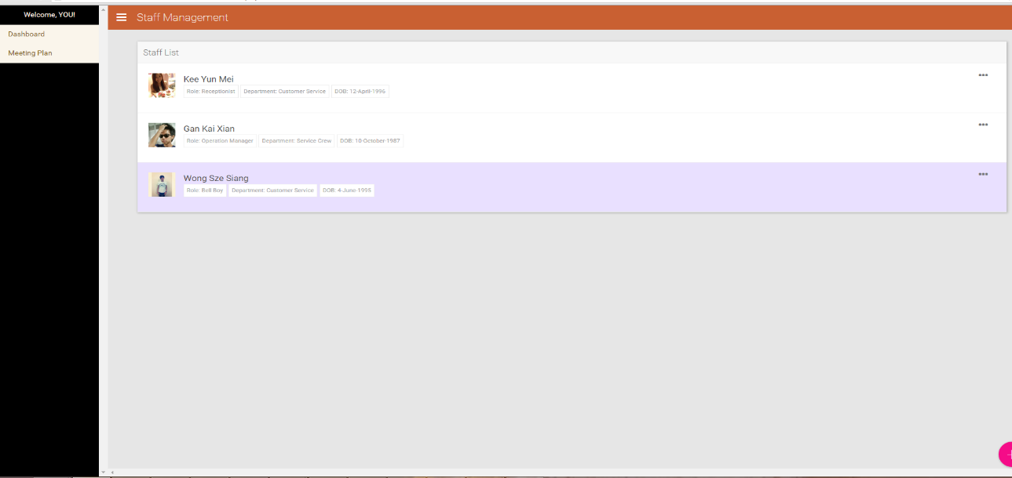
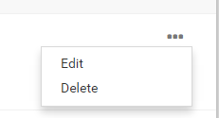
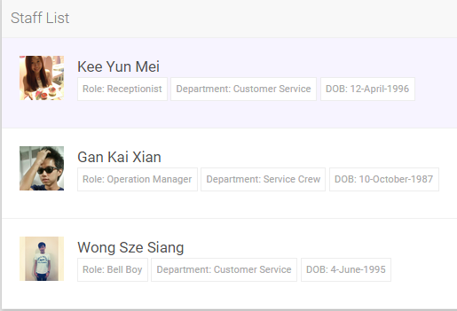
User Interface Design

Slide 29
Program Design
Use Case Diagram
VOPC Diagram
Booking
Housekeeping
Reporting

Slide 30
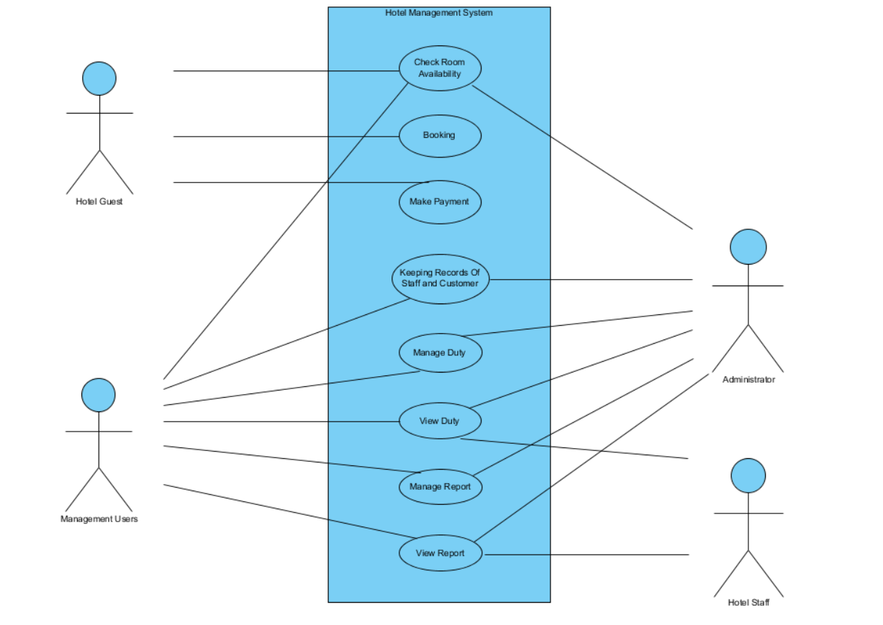
Use Case Diagram

Slide 31
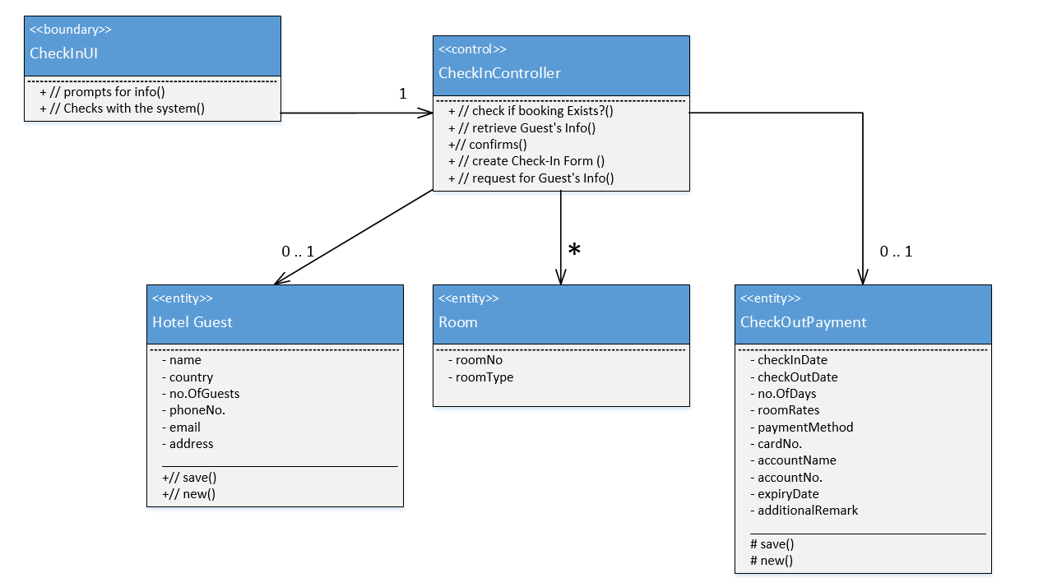
VOPC (Booking)

Slide 32
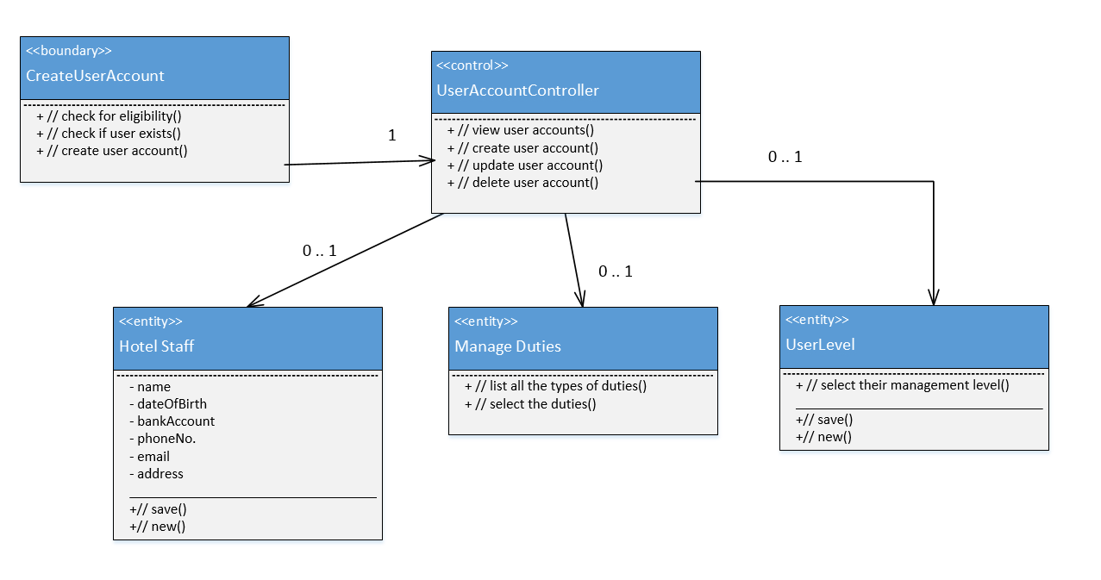
VOPC (House Keeping)

Slide 33
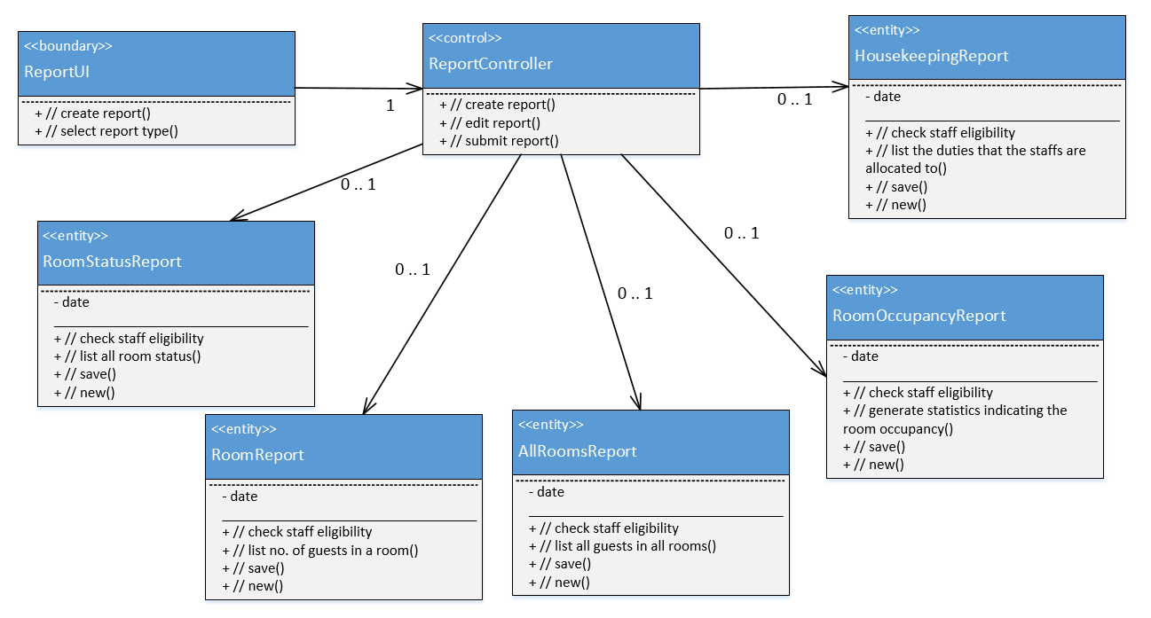
VOPC (Reporting)

Slide 34
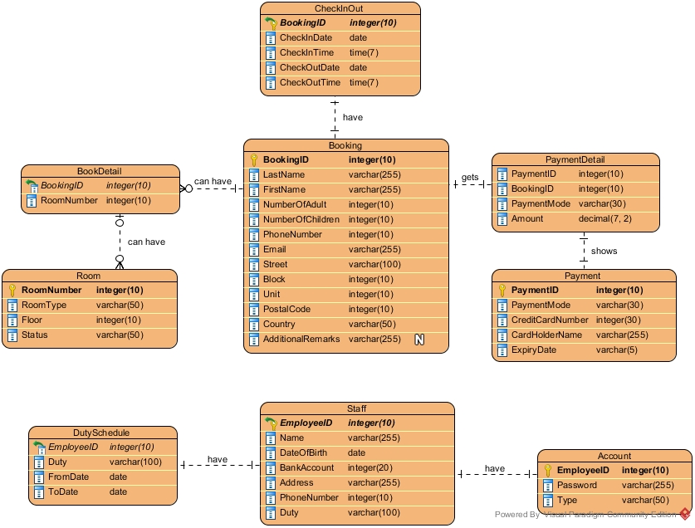
ERD

Slide 35
Approach used
3NF approach to simplify and minimize data redundancy.
Results into multiple tables that have its own purpose e.g. booking table stores the customer information while check in out table stores the check in and check out date and time.

Slide 36
Limitation
No report table is designed
Some report can be generated easily such as room occupancy report from room table or housekeeping report from duty schedule table
Reports such as all room and guest at a certain time report requires the used of more complicated SQL statement to retrieve and generate.

